Slide 1
Insurance Fraud Analysis and Detection
Created by – Eyong Divine
Date – May 17, 2022

Slide 2
Agenda
Discussing D3Graph
Exploring Plotly & Networkx
Graphistry Tool
Use of Machine Learning for Fraud Detection

Slide 3
D3Graph

Slide 4
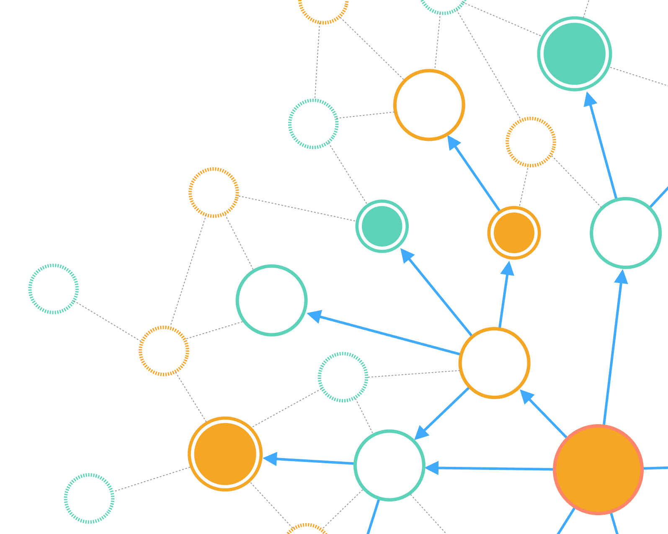
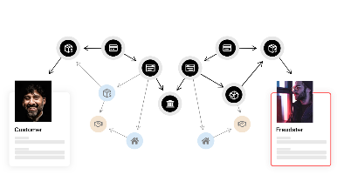

D3Graph
The d3graph library is a Python library that is built on D3 and creates a stand-alone, and interactive force-directed network graph.
The input data is an adjacency matrix for which the columns and indexes are the nodes and the elements with a value of one or larger are considered to be an edge.
The output is a single HTML file that contains the interactive force-directed graph.
D3graph features:- A slider that can break the edges of the network based on the edge value, a double click on a node will highlight the node and its connected edges and many more options to customize the network based on the edge and node properties.

Slide 5
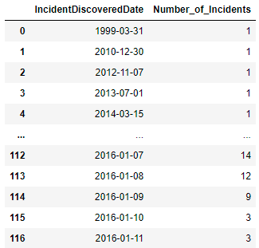
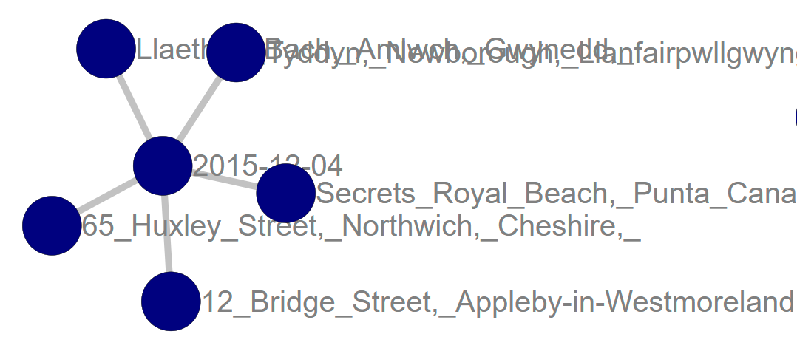
D3Graph - Example
As an example, I have explain the following scenario
Number of incidents on specific date in a specific address
First Calculate the Number of incidents on a specific day
Create Matrix of Incident Date and Address
Create Graph of these
Address
Address
Date
Address
This graph shows that 5 incidents occurs occurred on 12-04-2015

Slide 6
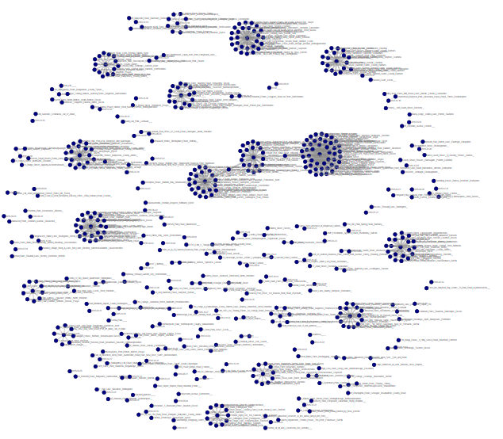
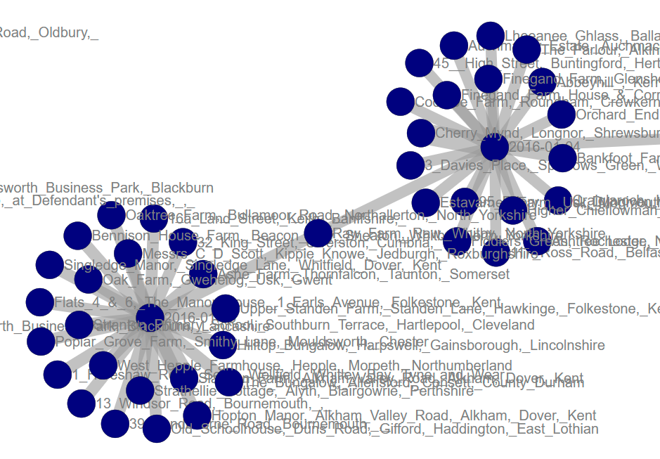
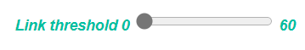
D3Graph - Example
I took 1000 data records (incidents)
Apply D3graph on data
And the result is
This is a place where two incident occurred on different dates
There is a slider which control the edges
Lets analyze the relations at different thresholds – if threshold is 40, means show only dates, where 40 or more incidents occurred

Slide 7
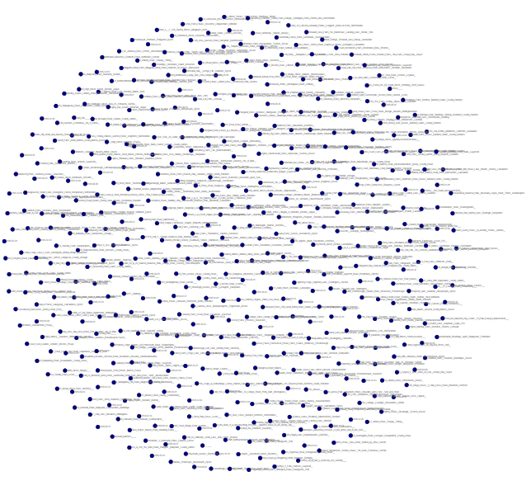
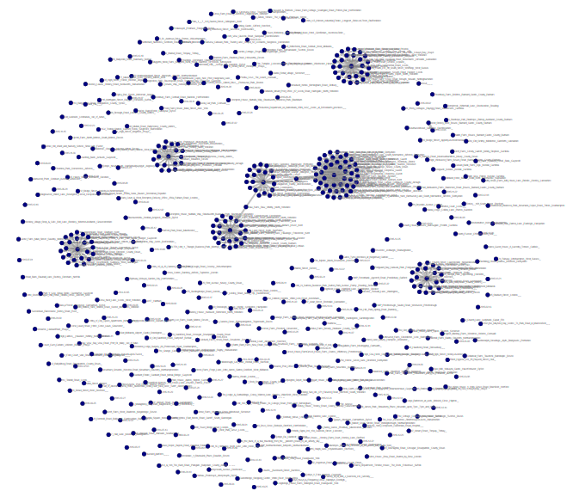
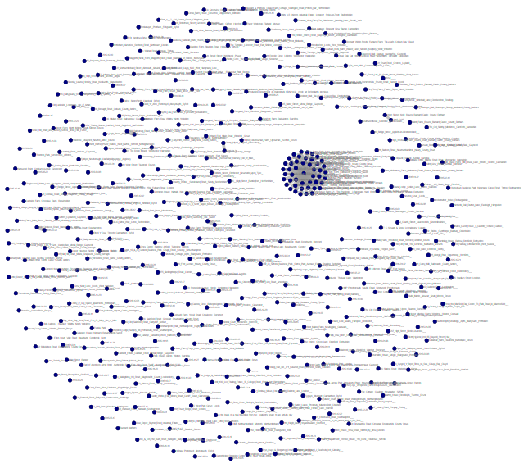
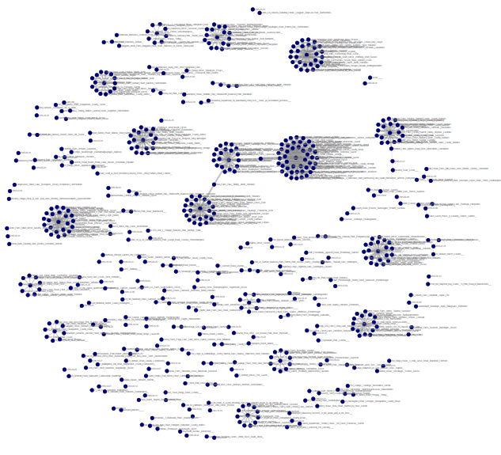
D3Graph - Example
Threshold 0 – Dates/ Address where 0 or more incidents
Threshold 10 – Dates/ Address where 10 or more incidents
Threshold 30 – Dates/ Address where 30 or more incidents
Threshold 60 – Dates/ Address where 60 or more incidents
If you want to play with this network, click here

Slide 8
D3Graph - Example
Pros
Easy to use in term of programming and understanding
Easy to understand the output
Output is an HTML page, which can used anywhere
Cons
There is specific format (matrix form) required to plot network, hence data needs to converted into that form first
Large dataset will need large memory
No automatic Machine Learning based fraud detection but shows/ give ideas about patterns

Slide 9
Plotly

Slide 10
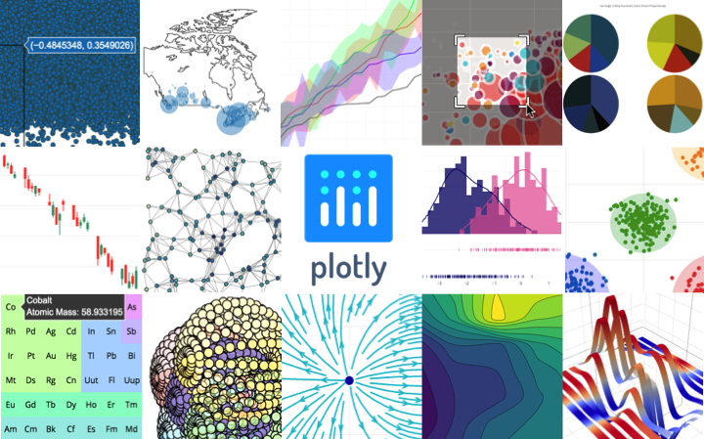
D3Graph
Plotly is Python graphics/ visualization library used for show AI/ ML results to business users for easy understanding
Examples of how to make line plots, scatter plots, area charts, bar charts, error bars, box plots, histograms, heatmaps, subplots, multiple-axes, polar charts, and bubble charts.

Slide 11
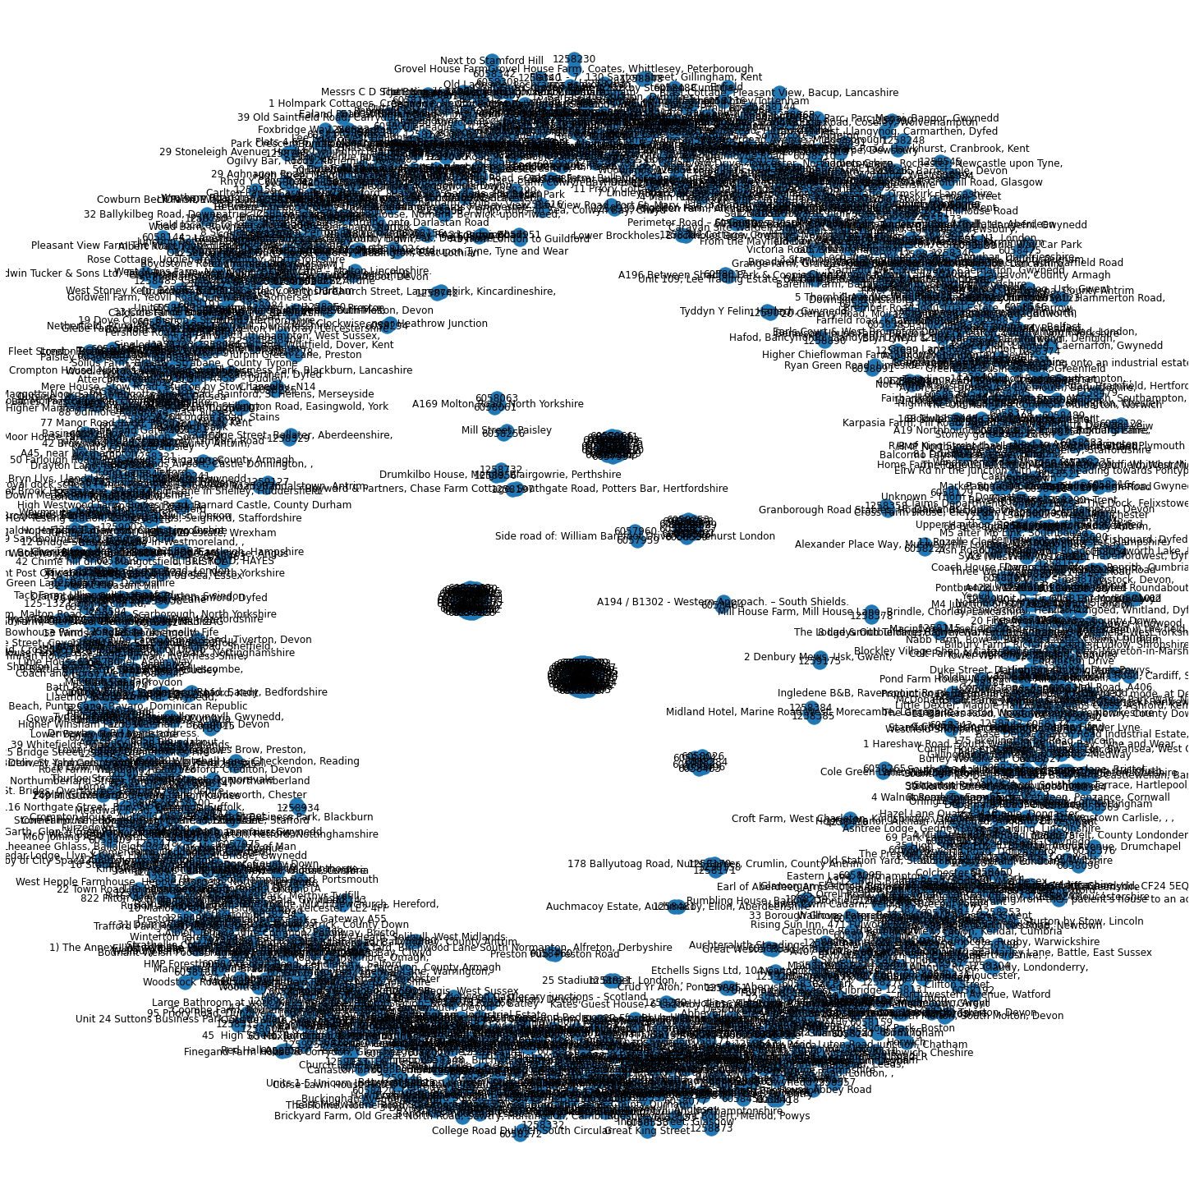
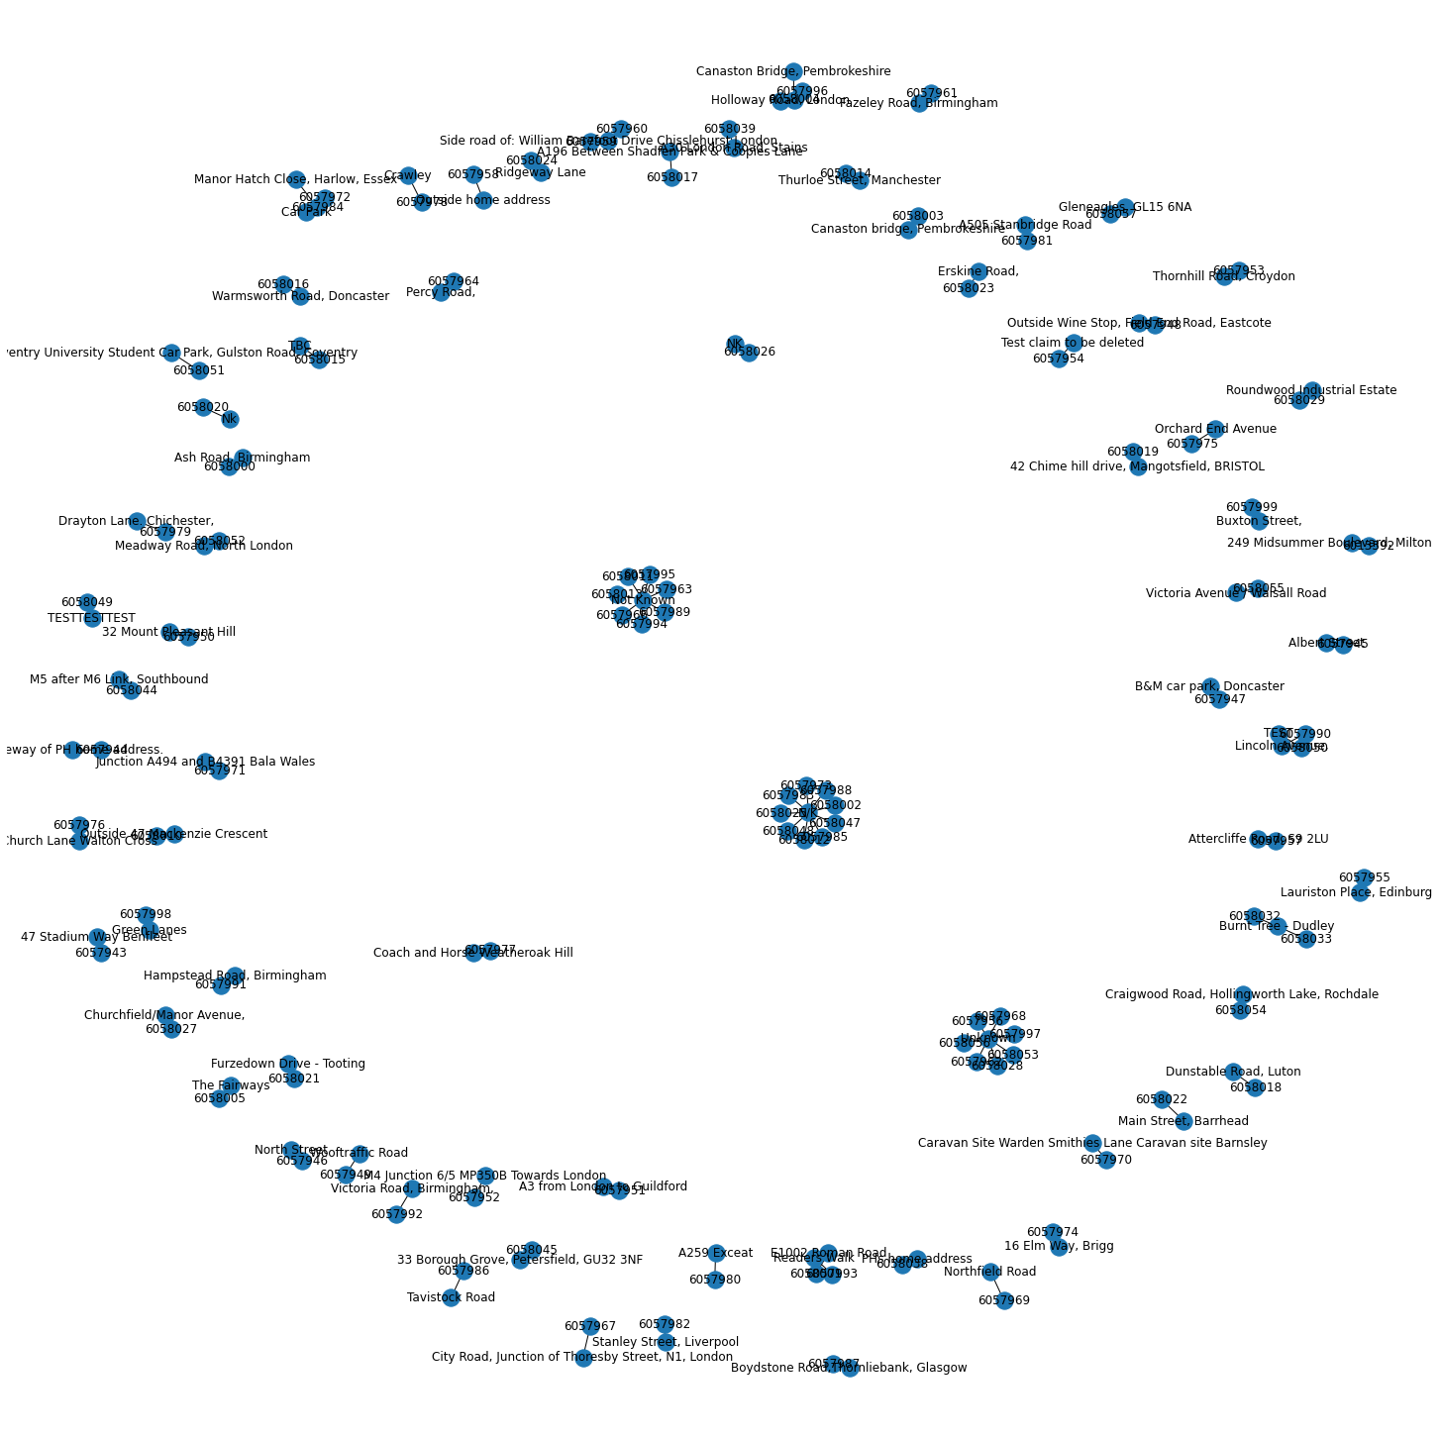
Plotly
Give diagram is Address – Incident ID network from fraud dataset (Not Readable due to large number of nodes – 1000 nodes/ edges), also the image is statics
Same scenario with 100 nodes/ edges
There is also an option of making Interactive/ Dynamic Graphs

Slide 12
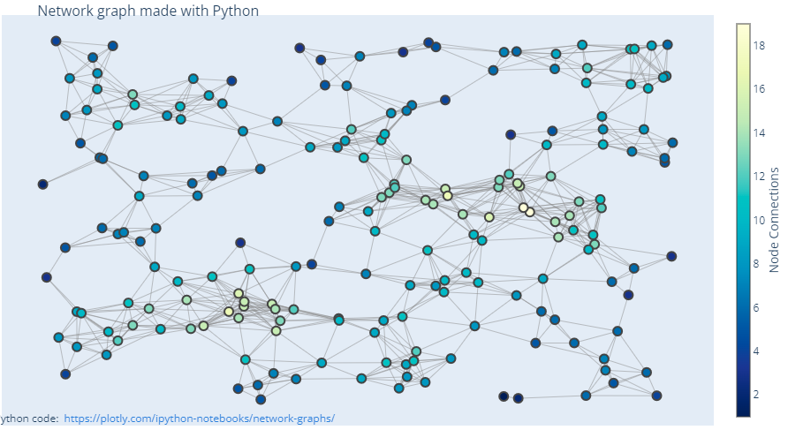
Plotly with Networkx
Plotly can be used with networkx to make interactive and complex network
Another framework called DASH, can be used with plotly to produce user friendly and easy to understand graphs
A lot of efforts required to convert fraud data into required format – same scenario explained

Slide 13
Plotly - Example
Pros
Very useful due to large number of visualizations
Easy to use – most widely used Python Library
Cons
Efforts required to represent our fraud data in this format
Efficient for small networks
No fraud detection capability

Slide 14
Graphistry

Slide 15
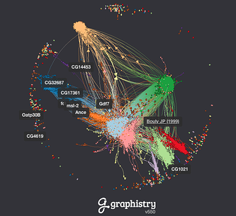
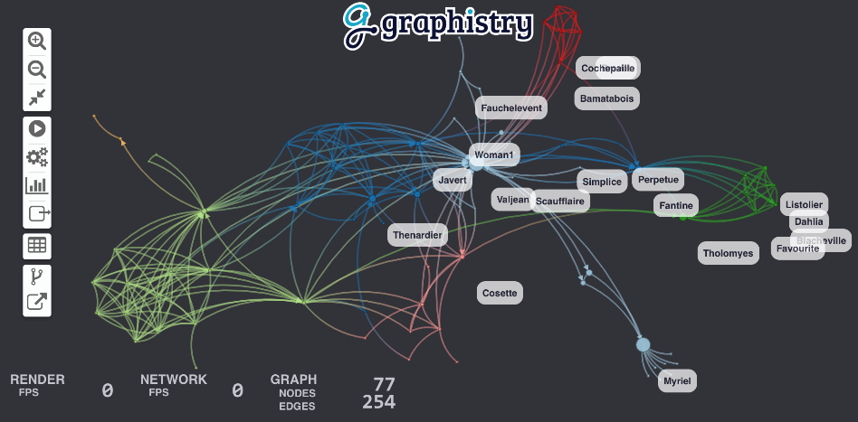
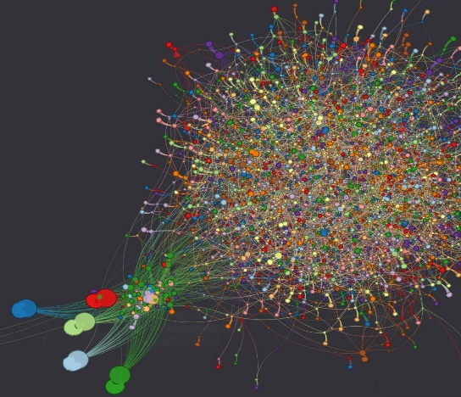
Graphistry
Graphistry brings visual graph intelligence to your big or complex data. It automatically transforms your data into interactive, visual maps built for the needs of analysts. Quickly surface relationships between events and entities with less time writing queries or wrangling data. As the first automatically GPU-accelerated platform, harness all of your data without worrying about scale, and pivot on the fly to follow anywhere your investigation leads you. Ideal for everything from security, fraud, and IT investigations to 360° views of customers and supply chains to mapping cancer mutations, Graphistry turns the potential of your data into human insight and value.

Slide 16
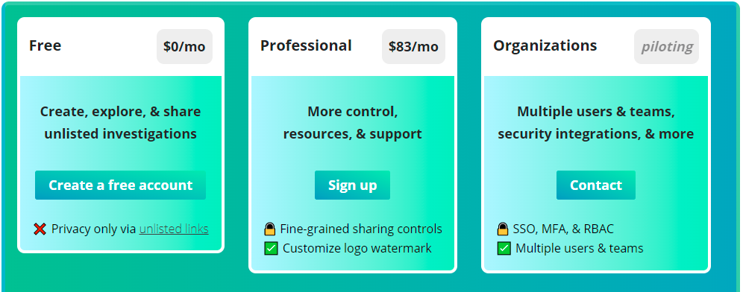
Graphistry - Setup
Select plan type

Slide 17
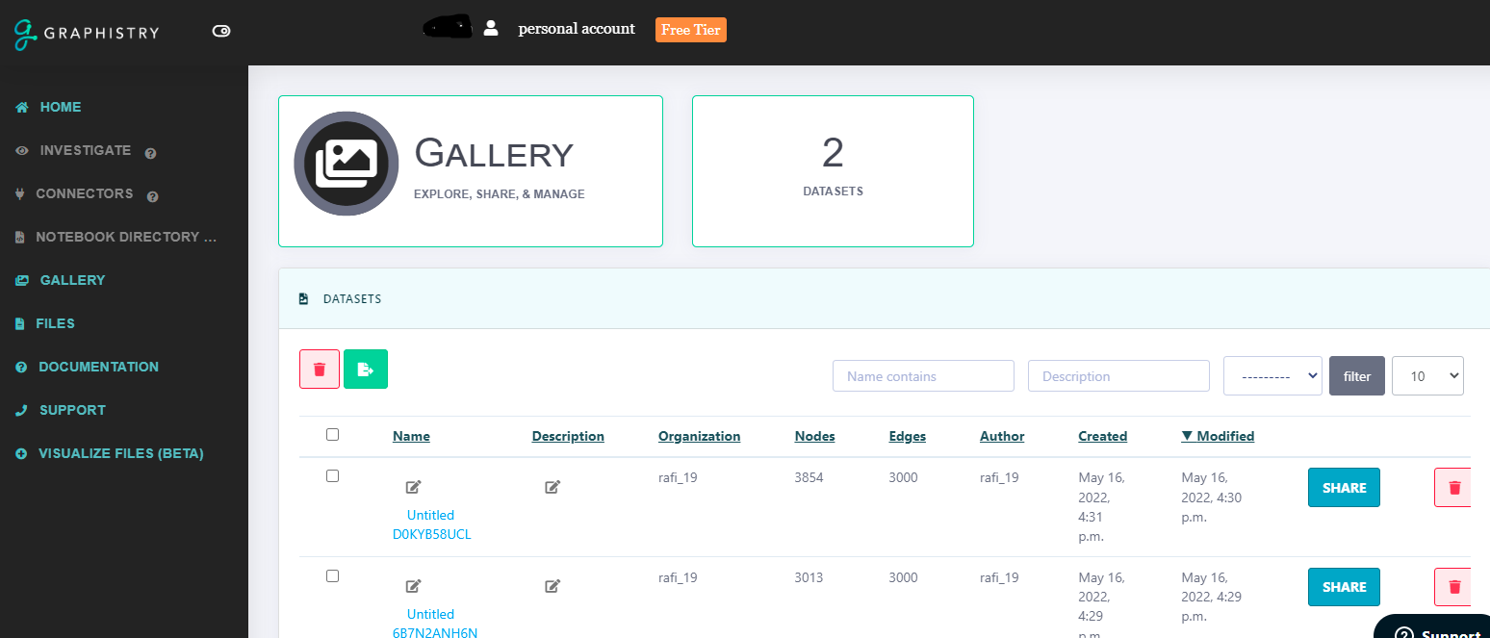
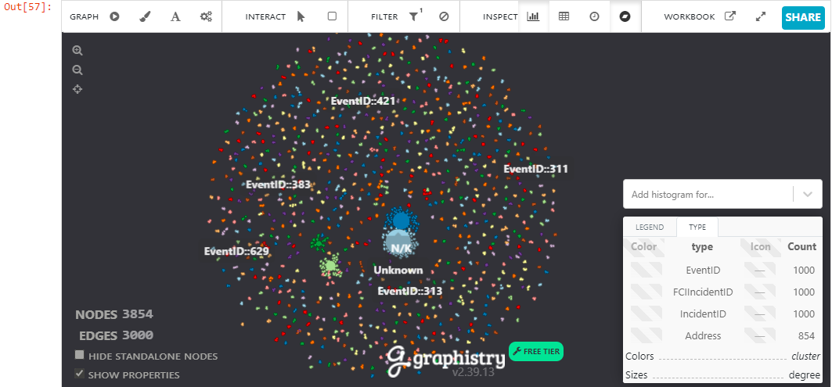
Graphistry - Setup
Once you create account, simple Python library to create graph
You can work on Notebook as we as Admin Panel

Slide 18
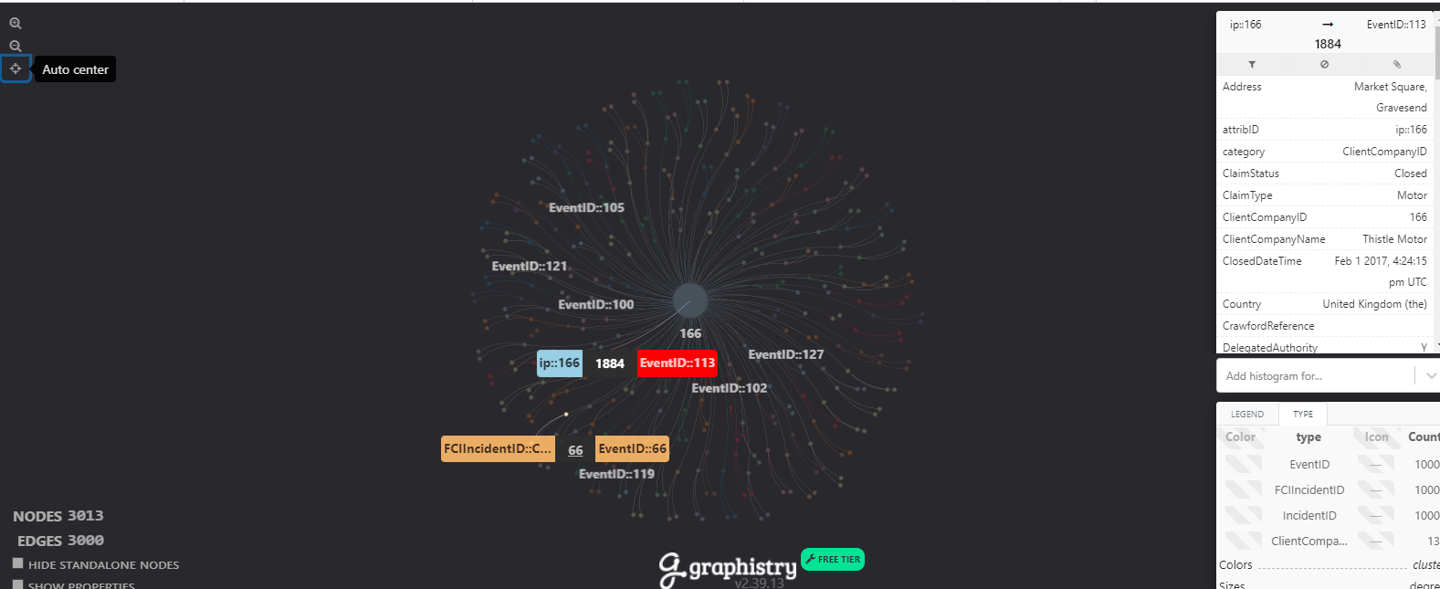
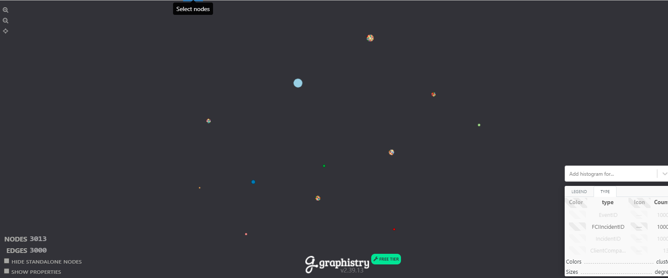
Graphistry - Setup
Click Here to see Live Demo

Slide 19
D3Graph - Example
Pros
Very easy to use
On cloud support and execution along with local
Details and Deep drill down capability
You can show as many features as you want as nodes
Cons
Limited features are free
Advance features such as GPU support, Custom Visuals/ filters required paid version

Slide 20
Machine Learning Model for Fraud Detection

Slide 21

Fraud Detection
None of the tool can really help you to identify/ detect fraud using available features, but only help you to get the idea and analyze the patterns
We need labelled dataset in order to train supervised machine learning model, which will detect whether given claim is fraud or not?
In case we don’t have labelled dataset, we need to analyze data and make features and apply unsupervised machine learning to find anomalies (outliers in claim supposed to be fraud)

Slide 22
Thank you

